Slide 1
CSE623 - Group XYZ
Deploying Person Retreival System on Edge Devices
Meet Rathi AU2240106 B.Tech CSE
Aditya Agrawal AU2240153 B.Tech CSE
Harsh Panchal AU2240160 B.Tech CSE

Slide 2
Problem Statement
Deploying a person retrieval system based on CLIP code, which will be optimized with Low-Rank Adaptation (LoRA) on the edge device, which is Nvidia Jetson Orin AGX for assessing its real-time performance in resource-constrained environment.
Key challenges:
Computational Efficiency
Latency
Model Optimization
Hardware Compatibility
Real-Time Performance

Slide 3
ICFG-PDES PRS Dataset
The ICFG-PDES (Image and Contextual Feature Graph - Person Detection and Retrieval System) dataset, focusing exclusively on person images, is designed for tasks related to person retrieval and re-identification. This dataset contains images of individuals captured in various environments, making it ideal for developing and evaluating algorithms for person detection, tracking, and retrieval.
Images: 27000+ images
Annotations: split, person detection id and captions.
Dataset Features
Focus on Person Images
Contextual Information
Multiple Instances of Individuals

Slide 4
Methodology
Data Pipeline and Model Fine-Tuning:
Preprocessing:
Images: Resized to 224x224, normalized (mean=0.5, std=0.5) using torchvision transforms.
Text: Tokenized with CLIP processor (max length=77).
Model Architecture:
CLIP (ViT-B/32 + DistilBERT) with custom projection heads (512D embeddings).
Fine-tuned using LoRA for parameter efficiency (implied from context).
Training:
Contrastive loss: Aligns image-text embeddings via cosine similarity.
Optimizer: AdamW (lr=1e-5, weight decay=1e-4), batch size=32.
Objective: Maximize similarity for matching pairs, minimize for non-matching.
Challenges Addressed:
Handled multiple captions per image via unique label aggregation.
Mitigated embedding mismatches during training (from prior debugging).
Notes:
Scale invariant feature tranformation

Slide 5
Methodology
Optimizing for Edge: Quantization and TensorRT Integration:
Model Optimization:
Applied quantization (FP32/FP16/INT8) to reduce model size and latency.
LoRA fine-tuning minimized memory footprint .
ONNX Conversion:
Converted fine-tuned CLIP to ONNX using a custom dual-encoder model.
Architecture: ViT-B/32 (image) + transformer (text) with projection layers.
Dynamic batch sizing for flexible inference.
TensorRT Conversion:
Used trtexec to generate .engine files: trtexec --onnx=saac.onnx --fp16 --saveEngine=saac-trt-fp16.trt.
Calibrated INT8 models for precision-efficiency trade-off.
Edge Compatibility:
Addressed TensorRT engine compatibility for Jetson Orin AGX (from prior debugging).
Optimized I/O latency and dynamic resource scheduling.
Notes:
Scale invariant feature tranformation

Slide 6

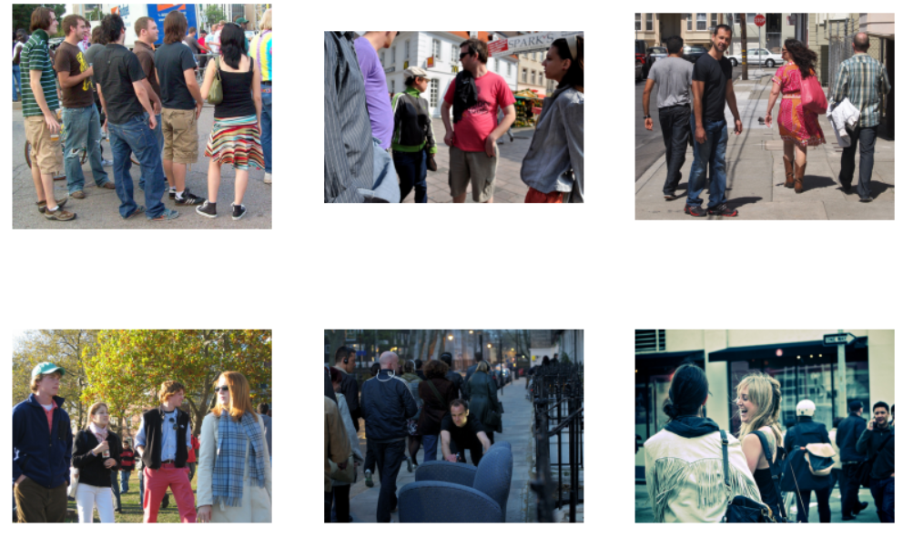
Results
Query: A group of friends on a walk
Query: A single person performing
A ritual

Slide 7
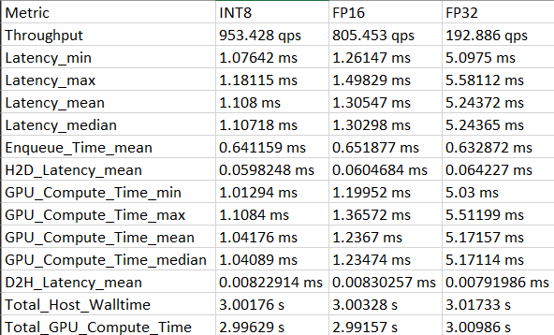
Results
TensorRT Conversion and Calibration Metrics for Jetson Deployment

Slide 8
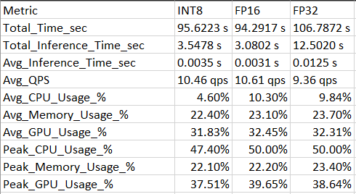
Results
Inference Performance:

Slide 9
References
[1] A. Radford, J. W. Kim, C. Hallacy, A. Ramesh, G. Goh, S. Agarwal,
G. Sastry, A. Askell, P. Mishkin, J. Clark, G. Krueger, and I. Sutskever,
”Learning Transferable Visual Models From Natural Language Super-
vision.”
[2] Z. Wu and S. Ma, ”CLIP-Based Multi-level Alignment for Text-based
Person Search.”
[3] M. Barnell and D. Isereau, ”Ultra Low-Power Deep Learning Applica-
tions at the Edge with Jetson Orin AGX Hardware,” in Proc. 2022 IEEE
High Performance Extreme Computing Conference (HPEC), 2022, doi:
10.1109/HPEC55821.2022.9926369.
[4] M. Ye, J. Shen, G. Lin, et al., ”Deep Learning for Person Re-
Identification: A Survey and Outlook,” IEEE Transactions on Pattern
Analysis and Machine Intelligence, vol. 44, no. 6, pp. 2872-2893, 2022.
[5] A. Radford, J. W. Kim, C. Hallacy, et al., ”Learning Transferable Visual
Models From Natural Language Supervision,” in Proceedings of the
International Conference on Machine Learning (ICML), 2021.
[6] J. Devlin, M. W. Chang, K. Lee, et al., ”BERT: Pre-training of Deep
Bidirectional Transformers for Language Understanding,” in Proceed-
ings of the 2019 Conference of the North American Chapter of the
Association for Computational Linguistics: Human Language Technolo-
gies, Association for Computational Linguistics, 2019, pp. 4171-4186.
[7] M. Barnell, C. Raymond, M. Wilson, D. Isereau, and C. Cicotta, ”Target
Classification in Synthetic Aperture Radar and Optical Imagery Using
Loihi Neuromorphic Hardware,” in Proc. 2020 IEEE High Perfor-
mance Extreme Computing Conference (HPEC), 2020, pp. 1-6, doi:
10.1109/HPEC43674.2020.9286246.
[8] D. Isereau, C. Capraro, E. Cote, M. Barnell, and C. Raymond, ”Utilizing
High-Performance Embedded Computing, Agile Condor, for Intelligent
Processing: An Artificial Intelligence Platform for Remotely Piloted
Aircraft,” in Proc. 2017 IEEE Intelligent Systems Conference (IntelliSys),
2017, pp. 1155-1159, doi: 10.1109/IntelliSys.2017.8324277.

Slide 10
Thank You

